Slide 1
Lecture 14: The Clean Air Act
Prof. Austin
Environmental Economics Econ 475

Slide 2


Why Regulate Air Quality?
“Dirty Air”
“Clean Air”
Created with DALL-E.

Slide 3
Why Regulate Air Quality?
Why did the U.S. federal government decide to regulate air quality?
Growing consciousness of environmental issues.
Cross-boundary pollution and the “race to the bottom.”
Competition to decrease regulations to attract firms.
Free riding by specific jurisdictions if improvements.
Lack of coordination by states increases uncertainty and costs of regulation for firms.

Slide 4
Background on the CAA
The 1970 Clean Air Act (CAA) passed after the first celebration of Earth Day and the creation of the Environmental Protection Agency.
Goal: “protect and enhance the quality of the Nation’s air resources so as to promote the public health and welfare and the productive capacity of its population.” (section 42 U.S.C. 7401(b)).
The Bill had unanimous support in the Senate and only one dissenting vote in the House.
Aside: The NBER didn’t hold its first environmental seminar series until 1991.

Slide 5
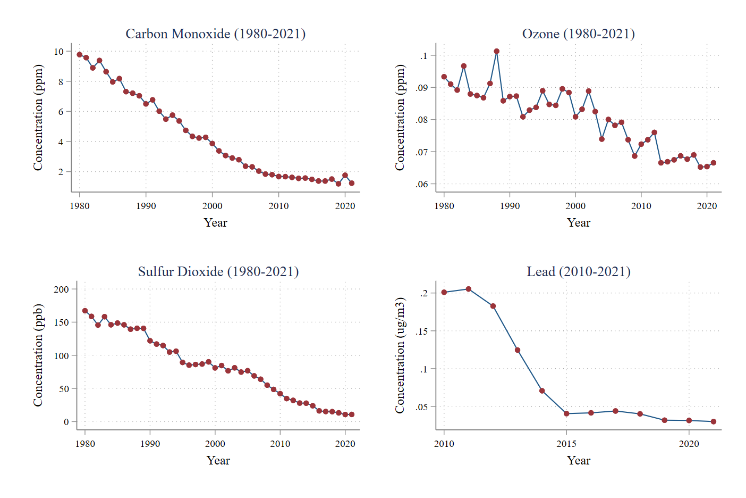
Why should we care about the CAA?
The Clean Air Act explains a large share of long-term decreases in air pollution (Shapiro, 2021).
From 2003-2012, reductions of just PM 2.5 accounted for one third to over half of the benefits of ALL significant federal regulations (Dominici, Greenstone, Sunstein, 2014).
Source: https://www.epa.gov/air-trends

Slide 6
Part 1: Four Provisions of the Clean Air Act

Slide 7
Four Provisions of the Clean Air Act
The 1970 Clean Air Act charged EPA with administering four key provisions of the CAA.
Promulgate National Ambient Air Quality Standards (NAAQS)
Identify pollutants created by diverse sources that have an “adverse effect on public health or welfare.”
Approve State Implementation Plans (SIPs)
SIPs are state plans to achieve attainment of the NAAQs. SIPs must be approved by EPA.
Develop New Source Performance Standards (NSPS)
EPA was charged with developing emissions standards for new major stationary sources such as power plants as well as mobile sources such as new vehicles.
Develop National Emission Standards for Hazardous Air Pollutants (NESHAPs)
NESHAPs control the emissions of air toxics, chemicals such as benzene that can cause cancer or other health issues. Air toxics are generally more localized than criteria pollutants.

Slide 8
National Ambient Air Quality Standards (NAAQS)
Key facts about the National Ambient Air Quality Standards (NAAQS):
Six criteria pollutants were identified as ubiquitous, created by diverse sources, and with adverse effects on public health or welfare.
These pollutants are carbon monoxide, lead, ground-level ozone, nitrogen dioxide, particulate matter, and sulfur dioxide.
EPA sets primary and secondary standards for these chemicals over specific time horizons. Standards are based on safety and welfare impacts.
Legally, EPA is not allowed to consider costs of control when setting NAAQS.

Slide 9
National Ambient Air Quality Standards (NAAQS)
Pollutant |  | Primary/ | Averaging Time | Level
 |  | Secondary
Carbon Monoxide (CO) |  | primary | 8 hours | 9 ppm
 |  |  | 1 hour | 35 ppm
Lead (Pb) |  | primary and | Rolling 3 month average | 0.15 μg/m3 (1)
 |  | secondary
Nitrogen Dioxide (NO2) |  | primary | 1 hour | 100 ppb
 |  | primary and | 1 year | 53 ppb (2)
 |  | secondary
Ozone (O3) |  | primary and | 8 hours | 0.070 ppm (3)
 |  | secondary
Particle Pollution (PM) | PM2.5 | primary | 1 year | 12.0 μg/m3
 |  | secondary | 1 year | 15.0 μg/m3
 |  | primary and | 24 hours | 35 μg/m3
 |  | secondary
 | PM10 | primary and | 24 hours | 150 μg/m3
 |  | secondary
Sulfur Dioxide (SO2) |  | primary | 1 hour | 75 ppb (4)
 |  | secondary | 3 hours | 0.5 ppm
Primary standards are limits set to protect human health, especially for susceptible individuals (e.g., those with asthma).
Secondary standards are based on welfare impacts (e.g., crop damage).
For more information, see https://www.epa.gov/criteria-air-pollutants/naaqs-table

Slide 10
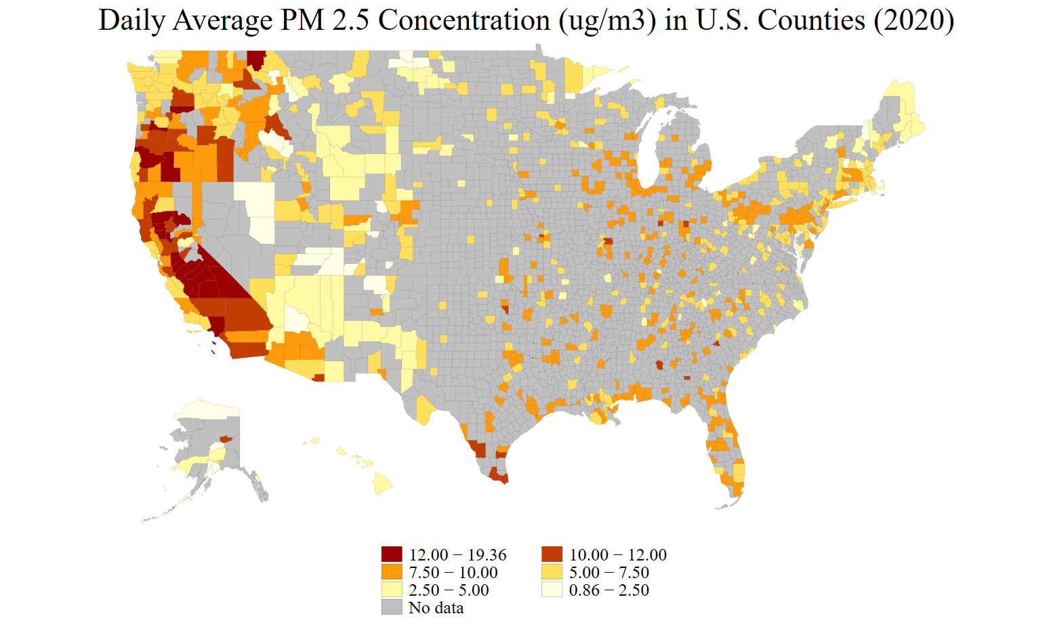
Created using EPA’s AirNow Query Tool of air quality monitor data. Last accessed September, 2021.

Slide 11
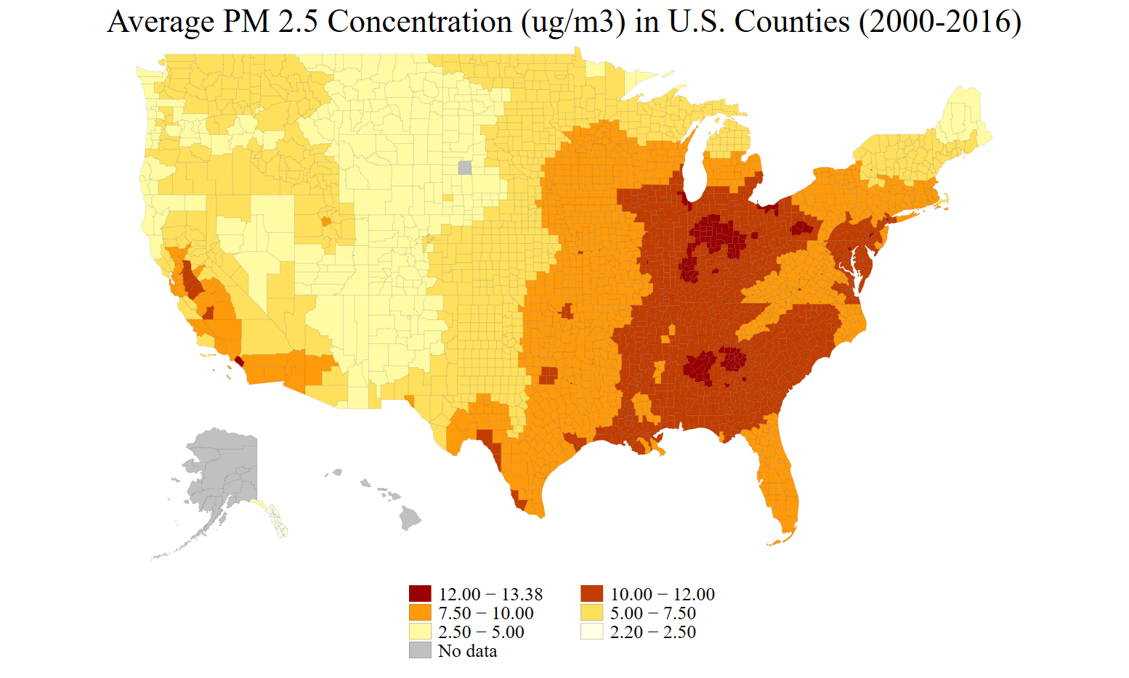
Created by extracting Atmospheric Composition Analysis Group Satellite-Based PM 2.5 Estimates. Last accessed August, 2020.

Slide 12
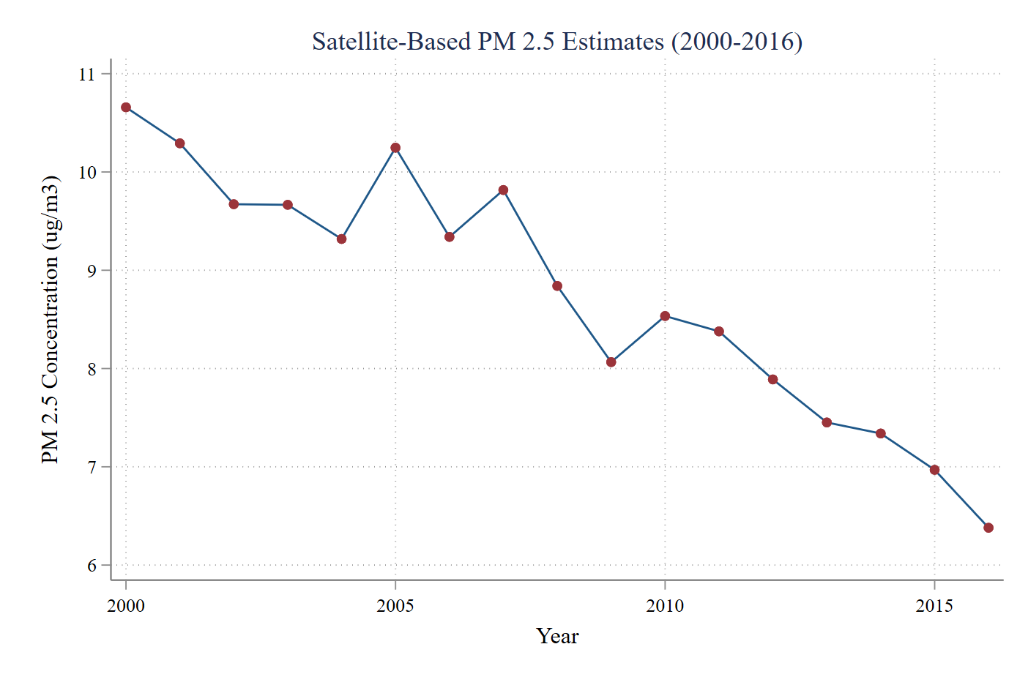
Created by extracting Atmospheric Composition Analysis Group Satellite-Based PM 2.5 Estimates. Last accessed August, 2020.

Slide 13
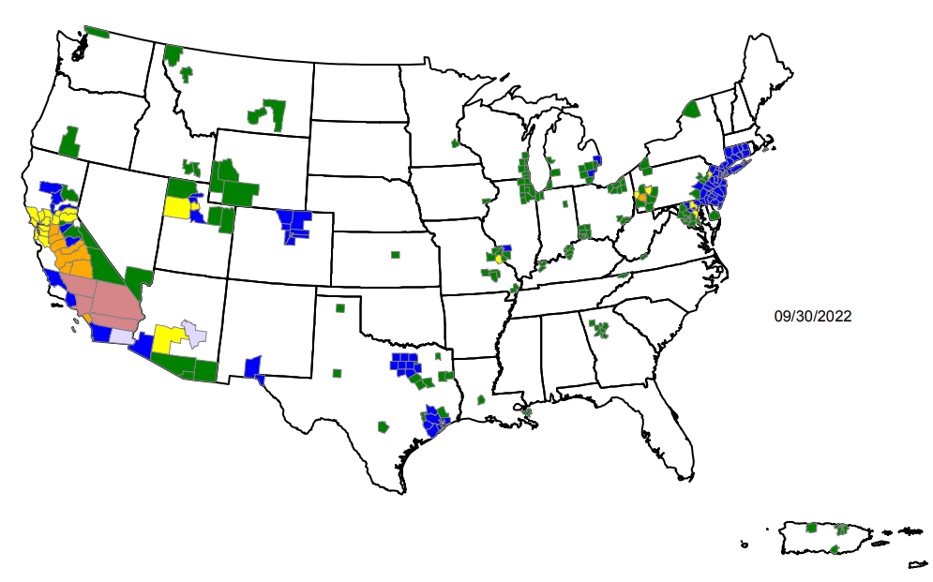
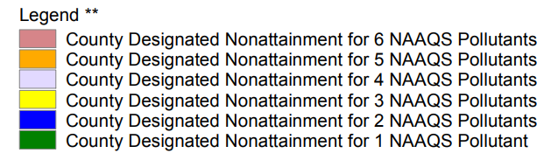
Non-Attainment Regions
Non-attainment regions have more stringent regulatory requirements:
New Source Review: permitting and review of any new major sources of criteria air pollutants, also mandatory offsets for new facilities after 1977.
The Green Book has information on all current non-attainment regions and their status for each criteria pollutant.

Slide 14
Four Provisions of the Clean Air Act
The 1970 Clean Air Act charged EPA with administering four key provisions of the CAA.
Promulgate National Ambient Air Quality Standards (NAAQS)
Identify pollutants created by diverse sources that have an “adverse effect on public health or welfare.”
Approve State Implementation Plans (SIPs)
SIPs are state plans to achieve attainment of the NAAQs. SIPs must be approved by EPA.
Develop New Source Performance Standards (NSPS)
EPA was charged with developing emissions standards for new major stationary sources such as power plants as well as mobile sources such as new vehicles.
Develop National Emission Standards for Hazardous Air Pollutants (NESHAPs)
NESHAPs control the emissions of air toxics, chemicals such as benzene that can cause cancer or other health issues. Air toxics are generally more localized than criteria pollutants.

Slide 15
State Implementation Plans (SIPs)
State Implementation Plans (SIPs) vary a lot across states, with some incorporating taxes, elements of cap-and-trade, and/or command-and-control approaches. Some common elements:
Each state is required to determine which areas within the state are in attainment, non-attainment, or unclassifiable for each criteria air pollutant.
The state must then create a SIP outlining how the state will:
Bring all areas in non-attainment into attainment.
Ensure attainment areas remain so through permitting of new facilities.
Submit the SIP to EPA for approval, then EPA must agree.
States may revise their SIP to designate new non-attainment areas or make adjustments to their plan after seeking public comment.

Slide 16
SIP Terminology
When states permit facilities to pollute, the Clean Air Act stipulates the types of standards they should require in the facility permit.
RACT, or Reasonably Available Control Technology, is required on existing sources in areas that are not in attainment. Cost can be considered.
BACT, or Best Available Control Technology, is required on major new or modified sources in areas that are in attainment. Cost can be considered.
LAER, or Lowest Achievable Emission Rate, is required on major new or modified sources in non-attainment areas. Costs are generally not considered.
In practice, these are hybrids of performance and technology standards, but there is almost always an envisioned set of technologies or practices for each standard. See the Technology Clearinghouse.

Slide 17
SIP Oversight
What if a SIP is not adequate to meet attainment according to the EPA?
EPA has several regulatory options:
Impose a Federal Implementation Plan.
Require or increase the amount of offsets for any new or modified source.
Withhold federal transportation funds.

Slide 18
Four Provisions of the Clean Air Act
The 1970 Clean Air Act charged EPA with administering four key provisions of the CAA.
Promulgate National Ambient Air Quality Standards (NAAQS)
Identify pollutants created by diverse sources that have an “adverse effect on public health or welfare.”
Approve State Implementation Plans (SIPs)
SIPs are state plans to achieve attainment of the NAAQs. SIPs must be approved by EPA.
Develop New Source Performance Standards (NSPS)
EPA was charged with developing emissions standards for new major stationary sources such as power plants as well as mobile sources such as new vehicles.
Develop National Emission Standards for Hazardous Air Pollutants (NESHAPs)
NESHAPs control the emissions of air toxics, chemicals such as benzene that can cause cancer or other health issues. Air toxics are generally more localized than criteria pollutants.

Slide 19
New Source Performance Standards (NSPS)
New Source Performance Standards (NSPS):
Organized around specific industries (“stationary sources”) or vehicles (“mobile sources”).
Typically focus on criteria air pollutants.
For each type of emitting facility, the regulator identifies an appropriate control technology and then sets an allowed emissions level based on that technology (i.e., hybrid technology/performance standard).
Regulate new or modified existing sources of air pollution.
Incentive to keep dirtier facilities around.

Slide 20
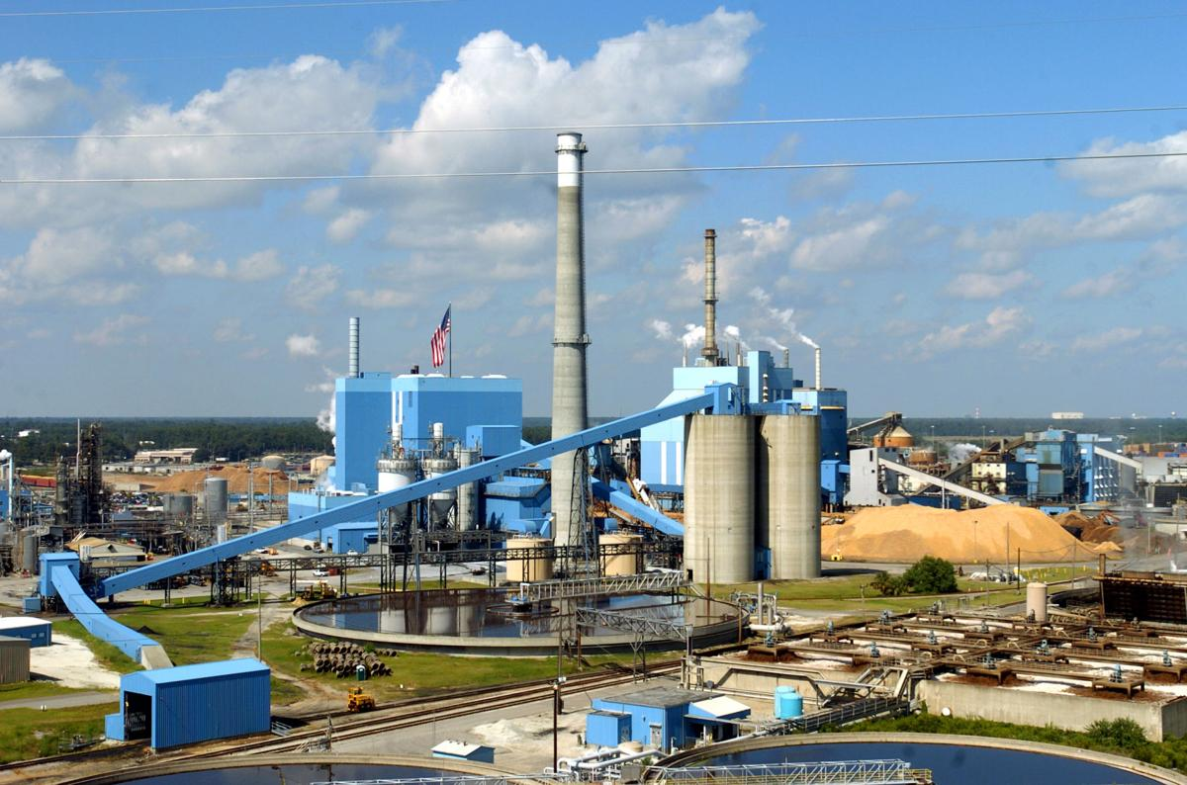
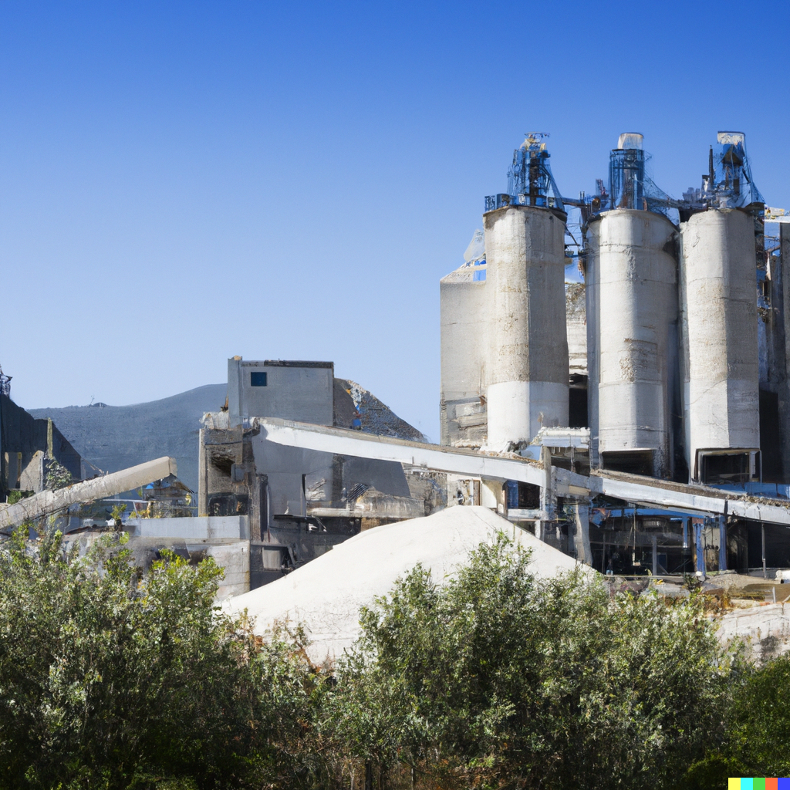
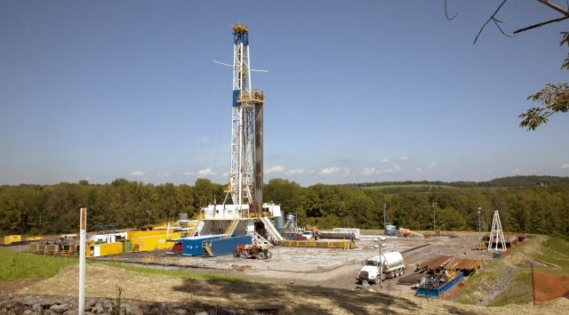
Examples of New Source Performance Standards (NSPS)
Many NSPSs on both stationary and mobile sources.
Some of the largest stationary sources:
Steam Generating Power Plants
Oil and Gas (includes fracking)
Steel Plants
Cement Plants
Paper Mills
Tire Manufacturing
Oil refineries
Source: Westrock Paper Mill in Charleston (above), a cement plant (top-left), a fracking well (left).

Slide 21
Aside on Stationary Sources
New Source Performance Standards apply to “stationary” and “mobile” sources. Stationary is a technical, regulatory, and legal term that is not necessarily intuitive and that varies for each regulation.
It could be a boiler with a smokestack (duh).
It could be the conveyer belt for a grain storage silo.
It could also be multiple fracking wells in close proximity.
It could even be distinct pumping stations along a gas pipeline, but not usually the entire pipeline.

Slide 22
Four Provisions of the Clean Air Act
The 1970 Clean Air Act charged EPA with administering four key provisions of the CAA.
Promulgate National Ambient Air Quality Standards (NAAQS)
Identify pollutants created by diverse sources that have an “adverse effect on public health or welfare.”
Approve State Implementation Plans (SIPs)
SIPs are state plans to achieve attainment of the NAAQs. SIPs must be approved by EPA.
Develop New Source Performance Standards (NSPS)
EPA was charged with developing emissions standards for new major stationary sources such as power plants as well as mobile sources such as new vehicles.
Develop National Emission Standards for Hazardous Air Pollutants (NESHAPs)
NESHAPs control the emissions of air toxics, chemicals such as benzene that can cause cancer or other health issues. Air toxics are generally more localized than criteria pollutants.

Slide 23
National Emission Standards for Hazardous Air Pollutants (NESHAPs)
Key facts about National Emission Standards for Hazardous Air Pollutants (NESHAPs):
Control release of air toxics, aka “HAPs.”
For each NESHAP, a positive regulatory determination first requires EPA to make a list of all sources emitting the air toxic.
EPA develops Maximum Achievable Control Technologies (MACTs) for each new and existing major source.
NESHAPS includes “area sources” subject to Generally Available Control Technologies (GACTs).
NESHAPS do not require testing to confirm compliance, but they are legally enforceable.

Slide 24
Examples of NESHAPS
Currently, there are 188 NESHAPS with specific regulatory requirements. Some NESHAPs cover topics you might recognize:
Asbestos
Dry-Cleaning Facilities (perchloroethylene)
Wood furniture makers (formaldehyde, among other HAPs)
Others, not so much:
Miscellaneous Organic Chemicals Manufacturing (i.e., “MON-MACT”)
Hazardous Organic NESHAP: Synthetic Organic Chemical Manufacturing Industries (i.e., “HON-SOCMI”)

Slide 25
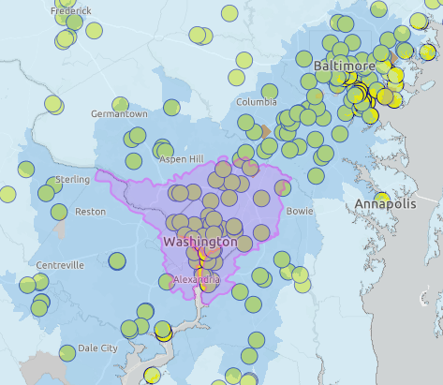
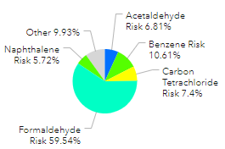
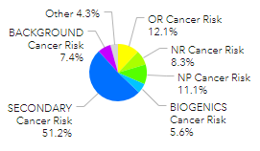
More on Air Toxics
The AirToxScreen mapping tool* can be used to investigate local air toxics and emissions sources.
(a) Risk by Air Toxic
Risk by Source Type
*AirToxScreen is only a screening tool, includes estimated concentrations, and does not capture all air pollutants.

Slide 26
Discussion Questions
Three questions and a video:
What types of regulatory instrument does the federal Clean Air Act promulgate?
What provisions of the Clean Air Act seem the most effective and why?
How would you do the act differently?

Slide 27
Part 2: Amending the Clean Air Act

Slide 28
Amending the CAA
Early amendments to the Clean Air Act, but otherwise progress has mostly stalled since 1990.
1977 Clean Air Act Amendments
Required scrubbers on power plants to remove sulfur dioxide.
Authorized simple emissions trading systems such as CA’s RECLAIM.
Offsets markets for areas in non-attainment.
Recent paper suggests that marginal benefit of abatement is roughly 10x higher than the price of an offset, a proxy for the marginal cost of abatement (Shapiro and Walker, 2020).
1990 Clean Air Act Amendment
Emissions trading and taxes on the production and use of stratospheric ozone depletion.
Acid Rain Control Program created sulfur dioxide allowances and trading.

Slide 29
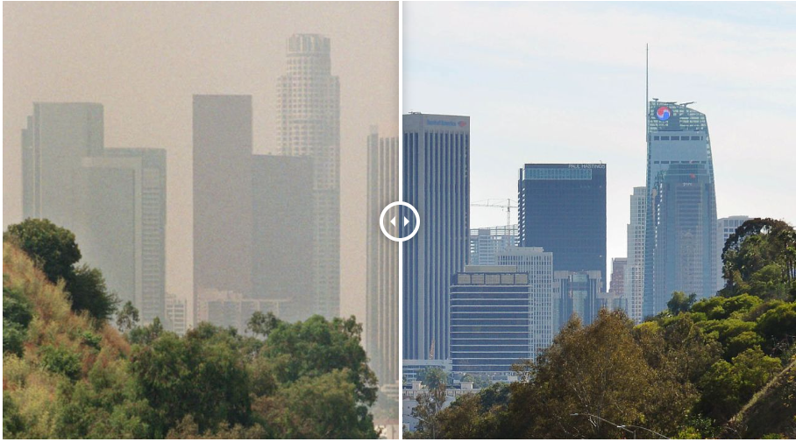
RECLAIM in California
Southern California has some of the worst air quality in the U.S. In 1994, it introduced the REgional CLean Air Incentives Market (RECLAIM) as part of its SIP.
350 facilities emitting more than four tons of NO2 or SO2 had to meet certain emissions standards, but any surplus reductions would become RECLAIM Trading Credits (RTCs).
New facilities had to purchase RTCs if they emitted these pollutants at sufficient quantities.
Source: Los Angeles has notoriously polluted air. But right now it has some of the cleanest of any major city, CNN, 2020.

Slide 30
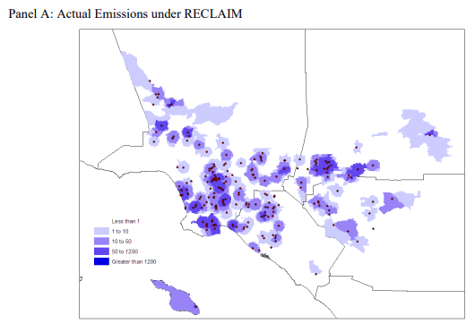
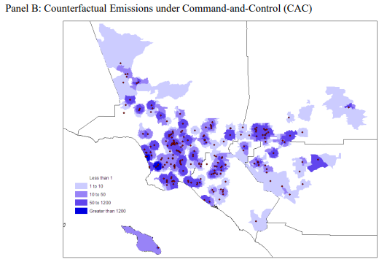
RECLAIM in California
Literature on RECLAIM is somewhat mixed. There are positive reviews:
Firms subject to the regulation reduced emissions by 20% compared to control facilities subject to command-and-control regulations and with large cost savings (Fowlie et al., 2012). Emissions of NO2 in the regulated area fell by 70% (Stavins, 2008).
Actual Emissions under RECLAIM and Counterfactual, Command-and-Control Emissions in tons of Nitrogen Oxides. Source: Fowlie et al., 2011

Slide 31
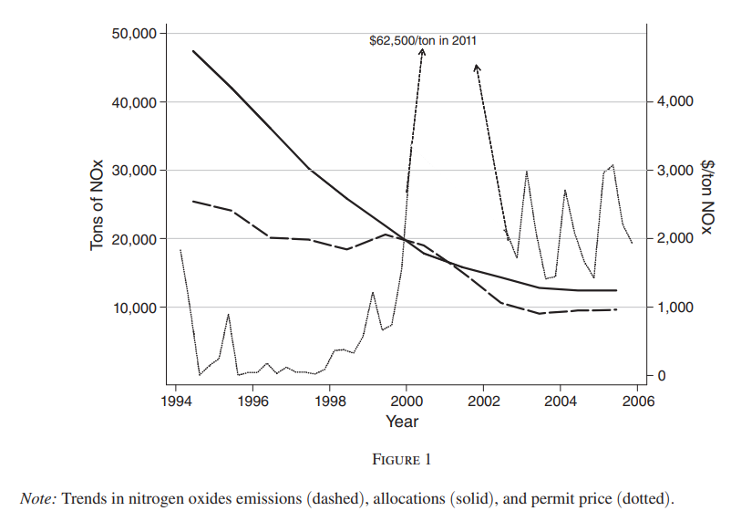
RECLAIM in California
Others have criticized the program:
Significant price volatility was politically costly. The regulated community was able to prevent additional lowering of the caps in the 2010s.
The emissions reductions may have taken place regardless, abatement progress stalled after 2012, and some firms were not installing the newest abatement technologies (Wang et al, 2022).
Ultimately, California decided to sunset their RECLAIM program, although they now have a GHG cap-and-trade program.
Source: Fowlie et al., 2012

Slide 32
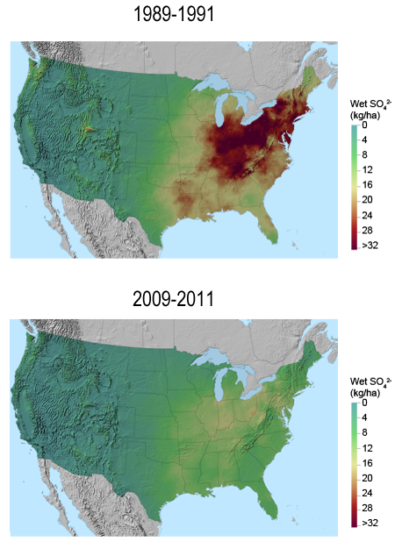
Acid Rain Control Program Basics
The Acid Rain Control Program was the first national cap-and-trade emissions program. Features:
Cap of sulfur dioxide emissions below 50% of 1980 levels.
36% reductions from 1990 to 2004, faster reductions than expected.
Continuous emissions monitoring of sulfur dioxide emissions at power plants.
Allowances handed out for free, except EPA withheld 2.8% of all allowances for an auction, the proceeds of which would go to new firms.
Firms could “bank” allowances.
Wet Sulfur Deposition. Source: EPA, 2022.

Slide 33
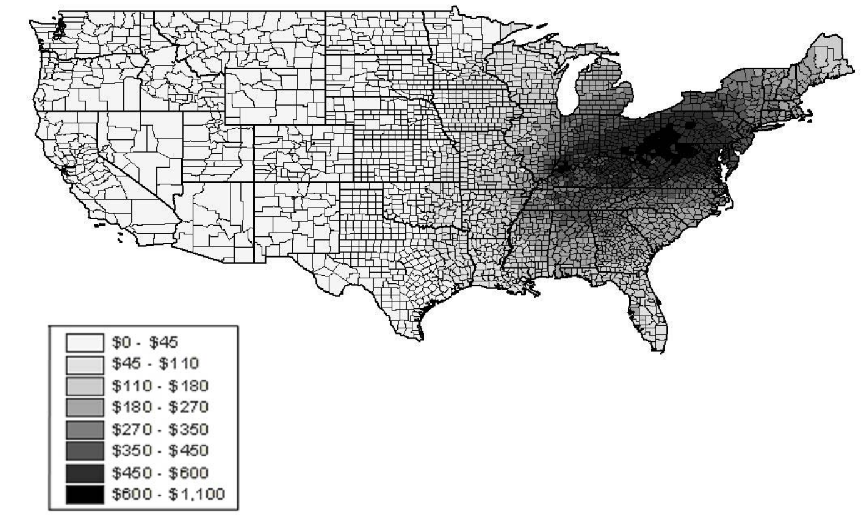
Impacts of the Acid Rain Control Program
Overview of the impacts:
Benefits were $56b and costs were only $556m (Shadbegian et al. 2005).
Most of the benefits were human-health based, not ecological responses.
Cost reductions were 15% to 90% of alternative command-and-control regulations.
Geographic Distribution of Net Benefits, 2005

Slide 34
More on Acid Rain Control Program
Reasons it worked well:
Requirements were set in advance of the first compliance period, so there was less uncertainty and litigation over the requirements.
Substantial allowance trade volume partly because transactions costs were reduced by removing requirements for approval by the regulator.
De-regulation of railroads made it cheaper to ship Wyoming low-sulfur coal as opposed to Appalachian high-sulfur coal.
Eventually, court decisions on the ability to modify the market and subsequent regulatory actions eliminated the market.

Slide 35
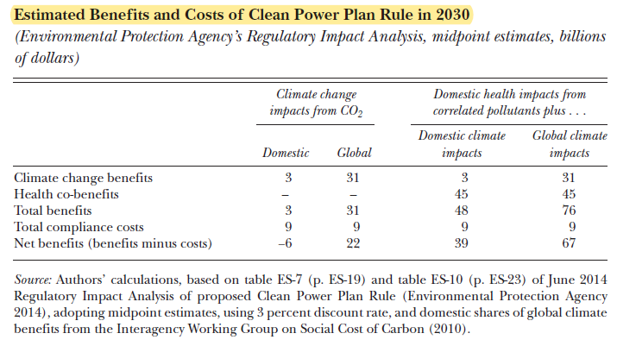
Other Developments Since 1990
Other developments:
Greenhouse Gas Endangerment Finding (2009)
Allows regulation of six GHGs because they endanger public health and welfare, meaning that EPA has authority to regulate them under the CAA.
2009 Waxman-Markey Bill:
Failed greenhouse gas cap-and-trade bill.
Obama-Era Regulations
NSPS for GHG emissions in the power sector that prevented new Coal-burning plants
Clean Power Plan affecting existing sources, wide range of policy instruments
Affordable Clean Energy Plan
Source: Schmalensee and Stavins (2019).

Slide 36
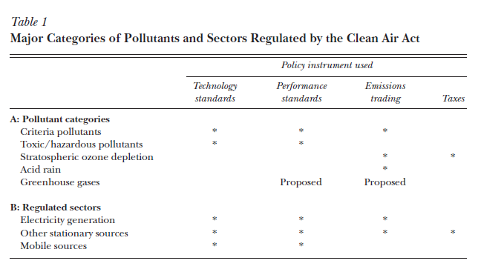
Brief Recap
Outdated: Section 111(b) of the CAA for new gas electric generating units.
Source: Schmalensee and Stavins (2019).

Slide 37
Part 3: Economics and the Clean Air Act

Slide 38
Economics and the CAA
The Clean Air Act requires a very multi-disciplinary support network. Atmospheric scientists, chemists, biologists, toxicologists, legal experts, etc., all play significant roles in development, implementation, and enforcement. What role have economists played?
Insights on incentives and behavior of the regulators and the regulated.
Monetizing unquantified endpoints can provide a strong benefit-cost policy argument for more-stringent regulations.
Causal inference to isolate new air pollution damage endpoints and improve accuracy of estimation for known damages.
Of course, many others…

Slide 39
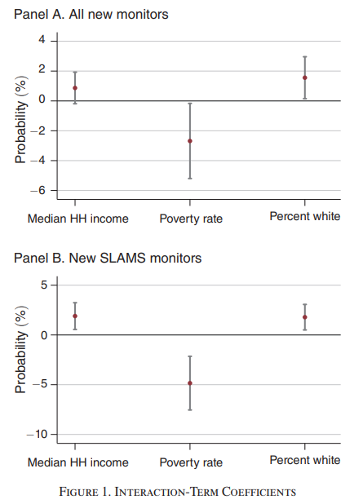
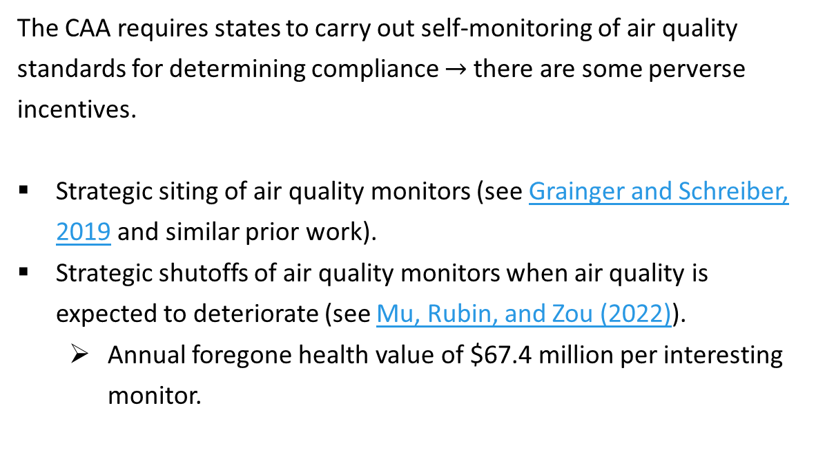
Monitoring Incentives under CAA
The CAA requires states to carry out self-monitoring of air quality standards for determining compliance $→$ there are some perverse incentives.
Strategic siting of air quality monitors (see Grainger and Schreiber, 2019 and similar prior work).
Strategic shutoffs of air quality monitors when air quality is expected to deteriorate (see Mu, Rubin, and Zou (2022)).
Annual foregone health value of $67.4 million per interesting monitor.

Slide 40
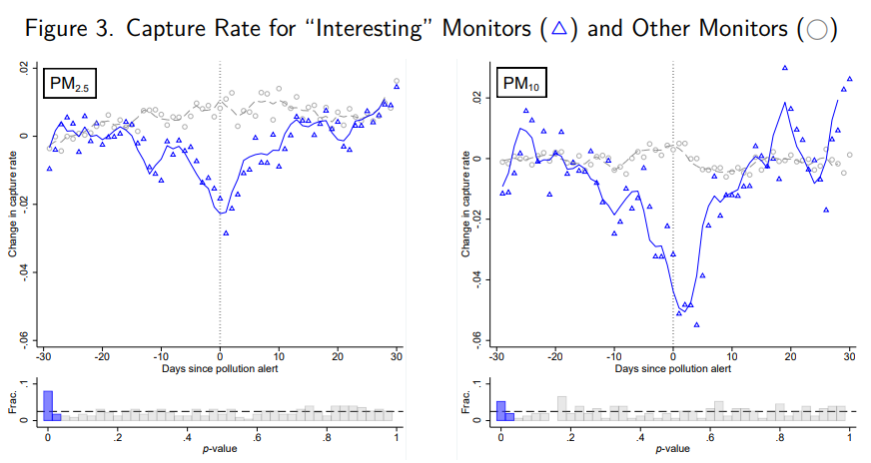
Mu, Rubin, and Zou (2022)
Check out this webmap to view all “interesting” monitors and download data from the study.

Slide 41
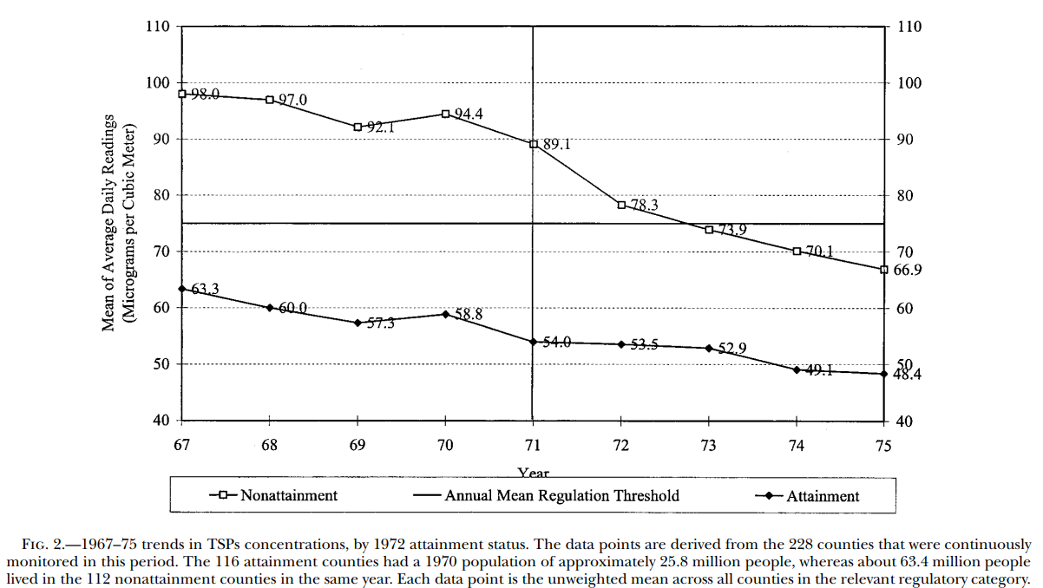
Chay and Greenstone (2005)
Authors use an instrumental variables approach based on non-attainment counties and total suspended particles (TSPS, or PM 10 and PM 2.5).
Non-attainment counties reduce air pollution by more than control counties. Time-constant county characteristics are absorbed with county fixed effects.
Hedonic price estimation of home values in non-attainment counties captures revealed preference of marginal willingness to pay for the change in TSPs.

Slide 42
Chay and Greenstone (2005)
All counties reduced TSPs, but non-attainment by 22 vs. 6 for attainment counties.
Authors use an instrumental variables approach based on non-attainment counties and total suspended particles (TSPS, or PM 10 and PM 2.5).
Non-attainment counties reduce air pollution by more than control counties. Time-constant county characteristics are absorbed with county fixed effects.
Hedonic price estimation of home values in non-attainment counties captures revealed preference of marginal willingness to pay for the change in TSPs.

Slide 43
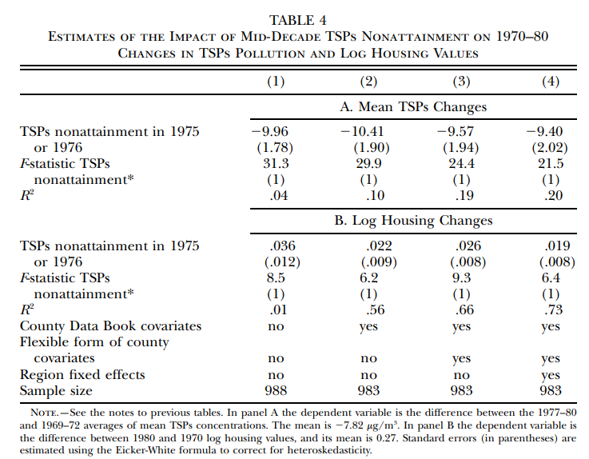
Chay and Greenstone (2005)
Key findings:
Counties in non-attainment reduced TSPs by 9-10 (ug/m3) as a result of the Clean Air Act’s NAAQs requirements.
Housing values in these regions increased by 2-3.6% as a result of these changes. Roughly $5000 in today’s dollars.
Total benefits from 1970-1980 estimated to be $45 billion.

Slide 44
Chay and Greenstone (2005)
Key findings:
Counties in non-attainment reduced TSPs by 9-10 (ug/m3) as a result of the Clean Air Act’s NAAQs requirements.
Housing values in these regions increased by 2-3.6% after CAA non-attainment status designated. Roughly $5000 in today’s dollars.
Total benefits from nonattainment status 1970-1980 estimated to be $45 billion.

Slide 45
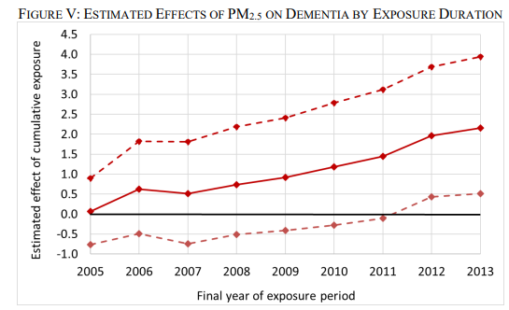
Clean Air and Cognitive Performance
Economics papers have demonstrated causal relationships between air pollution exposure and productivity, cognitive performance, and dementia.
Worse air pollution lowers fruit harvesting speeds (Neidel, 2017).
Lowers performance on the Bagrut, an SAT-like exam in Israel (Lavy et al., 2014).
Increases risk of dementia by 2.2 PP or 11% from mean (Bishop et al., 2022)
These studies allow lower health thresholds when setting standards and more benefits when citing permits.

Slide 46
Part 4: Discussion of Hernandez-Cortes, Meng, and Weber (2022)

Slide 47
Hernandez-Cortes, Meng, and Weber (2022)
Research question: How has exposure to air pollution from the fossil fuel electricity sector changed over time and for whom?
Methods:
Continuous Emissions Monitoring Systems (CEMS) information on all electricity-generating units producing over 25 MW.
Energy Information Administration (EIA) Form 860 on plant characteristics.
InMAP emissions pollution transport model.
For each location (and community), can now calculate population-weighted pollution exposures attributable to each type of facility and type of fuel.

Slide 48
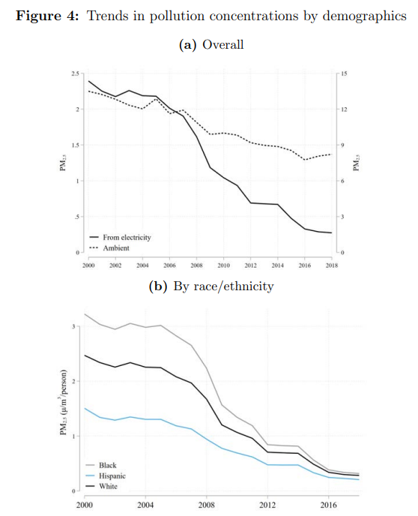
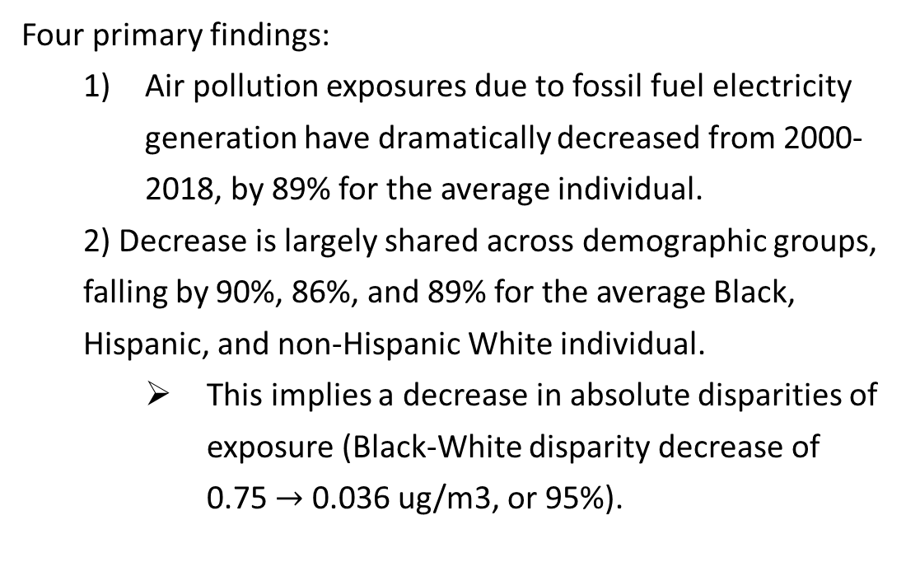
Hernandez-Cortes, Meng, and Weber (2022)
Four primary findings:
Air pollution exposures due to fossil fuel electricity generation have dramatically decreased from 2000-2018, by 89% for the average individual.
2) Decrease is largely shared across demographic groups, falling by 90%, 86%, and 89% for the average Black, Hispanic, and non-Hispanic White individual.
This implies a decrease in absolute disparities of exposure (Black-White disparity decrease of 0.75 $→$ 0.036 ug/m3, or 95%).

Slide 49
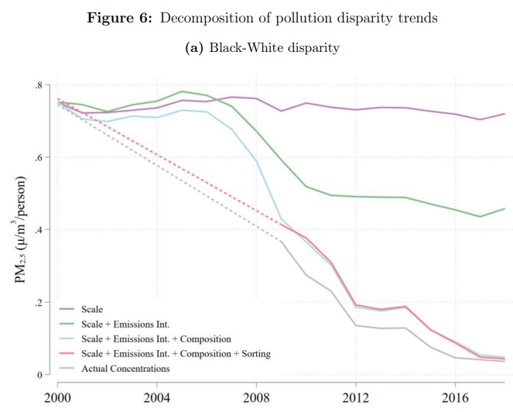
Hernandez-Cortes, Meng, and Weber (2022)
Four primary findings:
3) Trends in disparities are equally attributable to lowered emissions at a given unit and changes in the types of generating units, not migration.

Slide 50
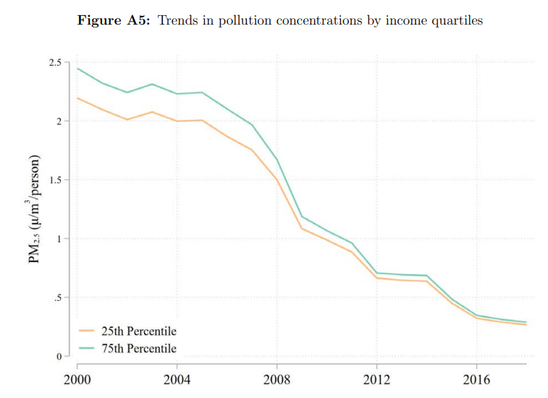
Hernandez-Cortes, Meng, and Weber (2022)
Last of the four findings:
4) Exposure disparities by income were always small, and mostly decreased proportionally.

Slide 51
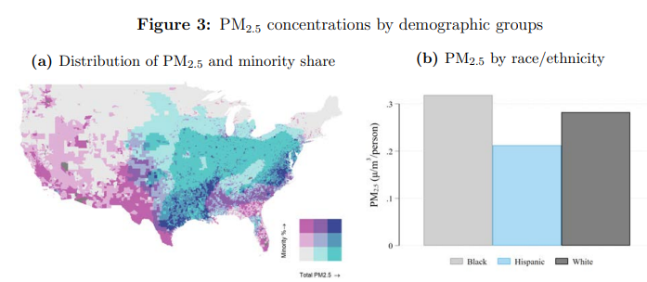
Hernandez-Cortes, Meng, and Weber (2022)

Slide 52
Hernandez-Cortes, Meng, and Weber (2022)
Discussion questions:
This paper is not directly about the Clean Air Act, but how do you think the findings speak to the CAA’s effects? Are certain conclusions clearly separable from the CAA?
What do you think of the paper? Is there anything you really liked or that surprised you? Is there something else you would want to know based on the data?

Slide 53
Next class
Next class will cover the Clean Water Act.
For Monday:
Please read Keiser and Shapiro (2019). It’s a great paper on the topic and it covers a lot of background on the CWA.
Your assignment Reflection Post #2 is due midnight on Sunday, October 23rd.

